Slide 1
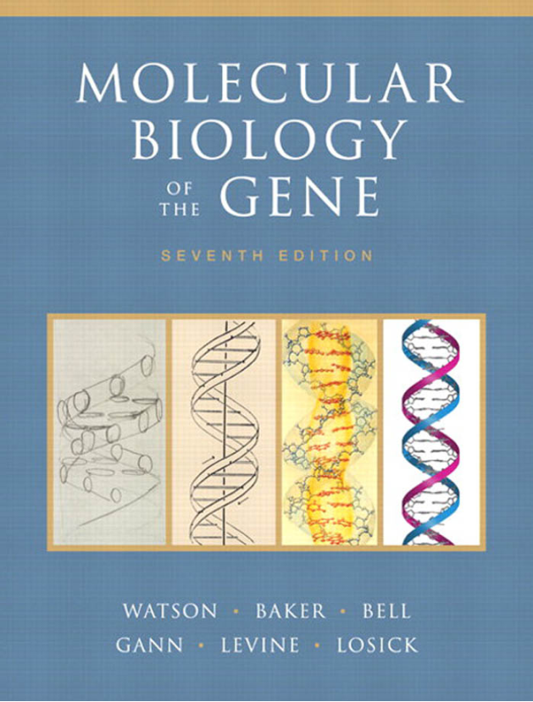

《分子生物学》第七讲
肖锐
2023.4.7. 珞珈山工学部6教201

Slide 2
Transcriptional Regulation in Prokaryotes 原核生物转录调控
Chapter 18
Rui Xiao

Slide 3
Outline
Principles of transcriptional regulation 转录调控的基本原理
Regulation of transcription initiation: examples from prokaryotes 转录起始调控
The case of bacteriophage λ: layers of regulation 噬菌体λ: 多层次的转录调控

Slide 4




Principles
Regulate

Slide 5
Gene Expression Is Controlled by Regulatory Proteins
Activators and repressors are DNA-binding proteins that recognize specific sites at or near the genes they control.
An activator increases transcription of the regulated gene, and repressors decrease or eliminate that transcription.

Slide 6
Most Activators and Repressors Act at the Level of Transcription Initiation
First, transcription initiation is the most energetically efficient step to regulate.
Second, regulation at this first step is easier to do well.

Slide 7
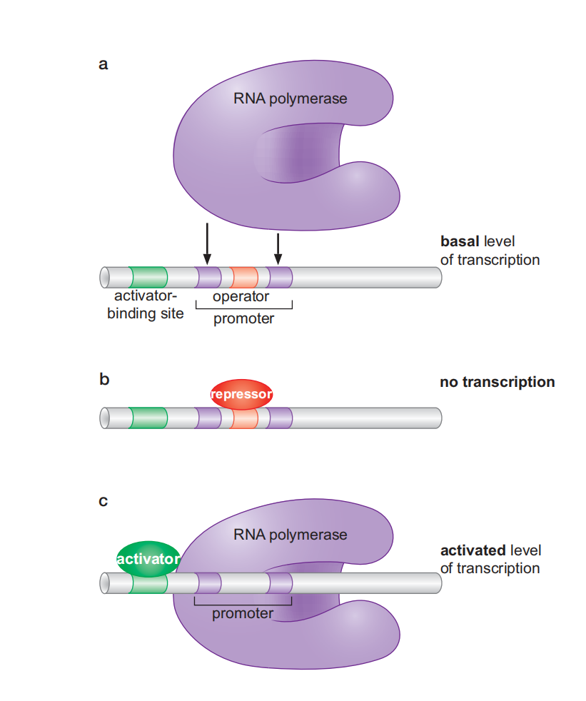

Basal Level of Transcription
Binding of RNA polymerase is the rate-limiting step in this case.
基础水平转录
At many promoters, in the absence of regulatory proteins, RNA polymerase binds only weakly and occasionally because of the absence of promoter elements or imperfection, resulting in a low level of constitutive expression called the basal level.

Slide 8
Repressors Prevent Transcription by Blocking RNA Polymerase Binding
Block
Repressors bind to a site overlapping the region bound by polymerase, thereby blocking its binding to the promoter and preventing transcription.
The site on DNA where a repressor binds is called an operator (操纵元件).

Slide 9
Activators promote transcription by Recruiting RNA Polymerase
Recruit
The activator uses one surface to bind to a site on the DNA near the promoter; with another surface, the activator simultaneously interacts with RNA polymerase, bringing the enzyme to the promoter. This mechanism, often called recruitment.

Slide 10
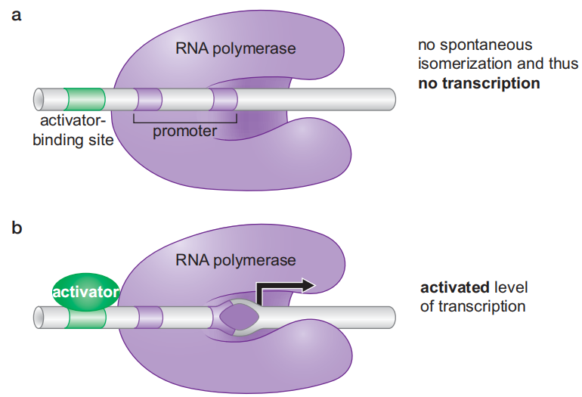
RNA polymerase binds efficiently unaided to some promoters but forms a stable closed complex
At this type of promoter, an activator must stimulate the transition from a closed to open complex, since that transition is the rate-limiting step.

Slide 11
Activator-Induced Allostery
Promote Transcriptional Initiation
Activators that stimulate this kind of promoter work by triggering a conformational change in either RNA polymerase or DNA.

Slide 12
Repressor-Induced Allostery
Inhibit Transcriptional Initiation
Inhibit
Repressor
Some repressors interact with polymerase at the promoter and inhibit transition to the open complex, or promoter escape.

Slide 13
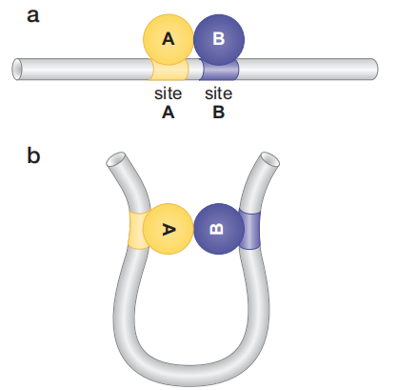
Factors that interact with each other
bind to adjacent sites

Slide 14
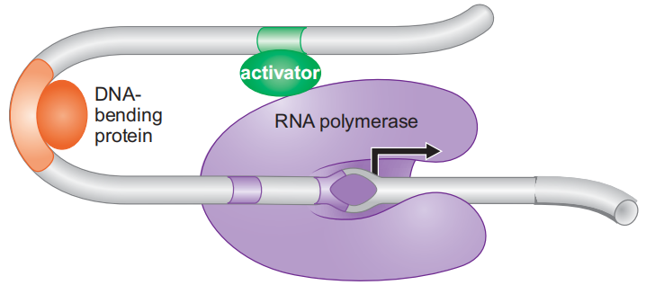
A DNA-bending protein can facilitate interaction between distantly bound
DNA-binding proteins
A DNA-bending protein can bind between an activator-binding site and the promoter and help the activator interact with polymerase by bending the DNA in a favorable direction.

Slide 15
Outline
Principles of transcriptional regulation 转录调控的基本原理
Regulation of transcription initiation: examples from prokaryotes 转录起始调控
The case of bacteriophage λ: layers of regulation 噬菌体λ: 多层次的转录调控

Slide 16
A Repressor Controls the Tryptophan(丝氨酸) operon
An Activator and a Repressor Together Control the lac Genes (the lac operon 乳糖操纵子)
Alternative σ Factors Direct RNA Polymerase to Alternative Sets of Promoters
NtrC and MerR: Transcriptional Activators That Work by Allostery (变构) Rather than by Recruitment
Gal Repressor Holds RNA Polymerase at the Promoter Rather than Excluding It
AraC and Control of the araBAD Operon by Antiactivation (阿拉伯糖操纵子)

Slide 17
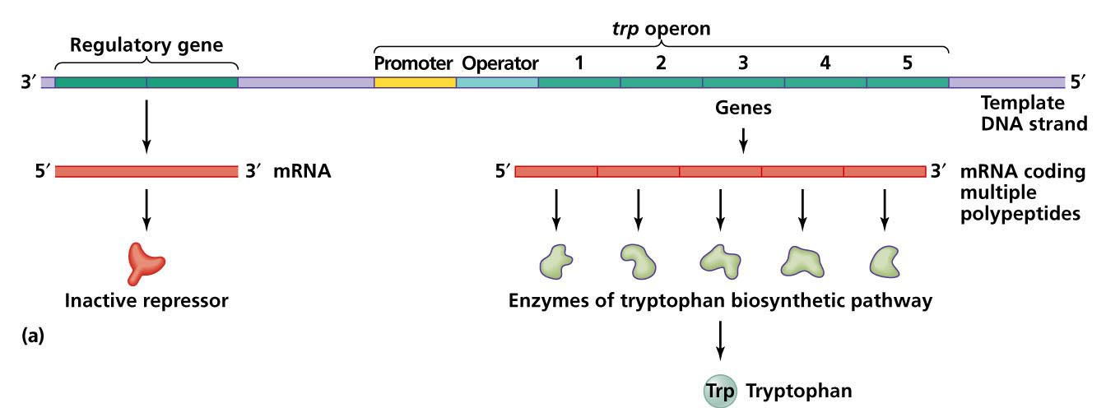
The tryptophan operon

Slide 18
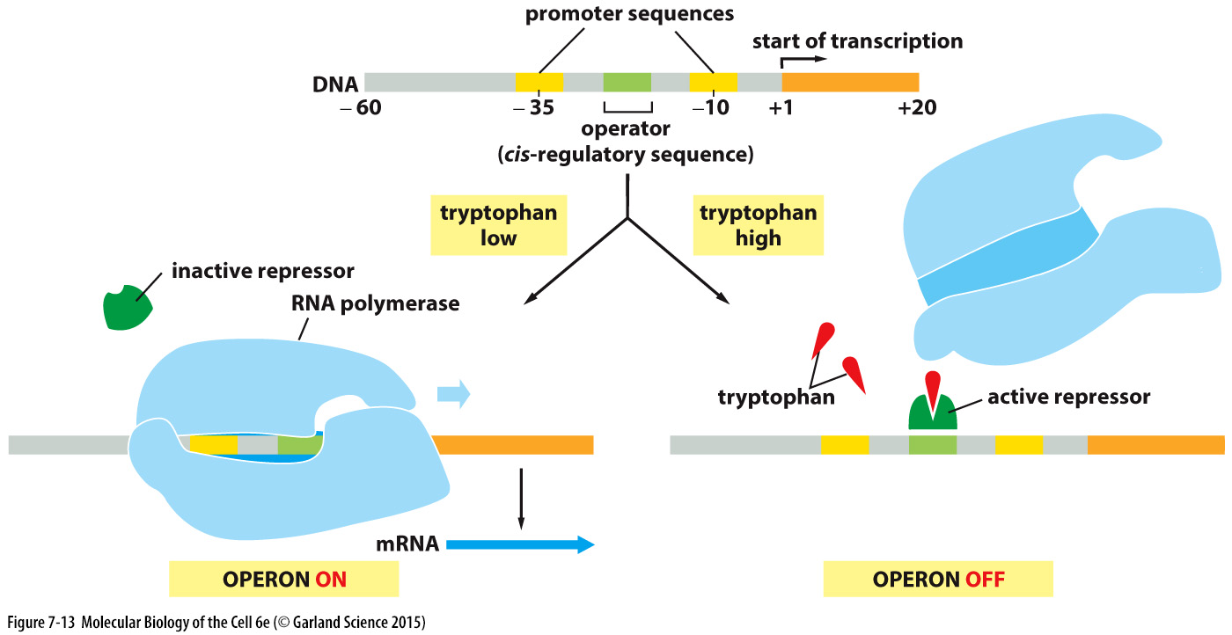
The tryptophan repressor
switches genes off
Negative feedback regulation
Notes:
举个经典的例子就是，大肠杆菌的tryptophan色氨酸操纵子的表达调控
如果色氨酸浓度低，repressor则处于inactive状态，operon呈开启状态；
如果色氨酸浓度高，repressor结合色氨酸配体后呈激活状态，这样它会结合operon，关闭operon；

Slide 19
A Repressor Controls the Tryptophan(丝氨酸) operon
An Activator and a Repressor Together Control the lac Genes (the lac operon 乳糖操纵子)
Alternative σ Factors Direct RNA Polymerase to Alternative Sets of Promoters
NtrC and MerR: Transcriptional Activators That Work by Allostery (变构) Rather than by Recruitment
Gal Repressor Holds RNA Polymerase at the Promoter Rather than Excluding It
AraC and Control of the araBAD Operon by Antiactivation (阿拉伯糖操纵子)

Slide 20
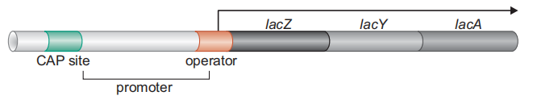
The lactose (lac) operon
β-Galactosidase
Permease
Transacetylase
β-半乳糖甘酶
通透酶
转乙酰酶
Lactose metabolism

Slide 21
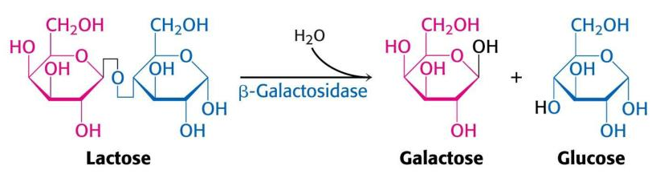
Lactose metabolism
β-galactosidase cleaves the sugar lactose into galactose (半乳糖) and glucose (葡萄糖), both of which are used by the cell as energy sources.
Hydrolysis (水解)

Slide 22
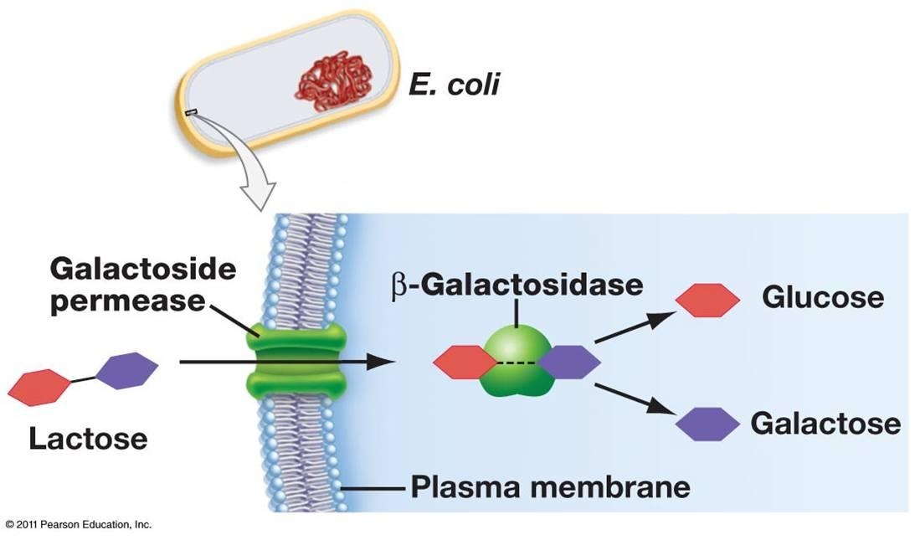
Lactose metabolism
Lactose permease, a protein that inserts into the cell membrane and transports lactose into the cell.

Slide 23
Lactose metabolism
Thiogalactoside (硫代半乳糖苷) transacetylase rids the cell of toxic thiogalactosides that also get transported in by permease.

Slide 24
An Activator and a Repressor
Together Control the lac Genes
These genes are expressed at high levels only when lactose is available, and glucose—the preferred energy source—is not.
Two regulatory proteins: CAP [CRP (also called cAMP receptor protein)], an activator, binds to CAP site;
Lac repressor (encoded by the lacI gene) binds to
the operator.
CAP mediates the effect of glucose, whereas Lac repressor mediates the lactose signal.

Slide 25
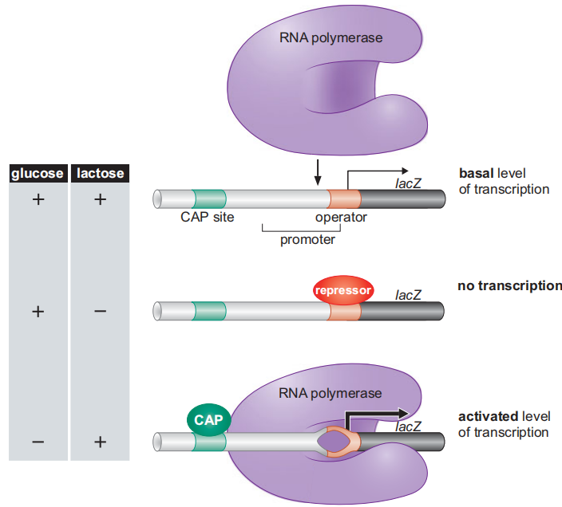
Orchestrating the Expression
of lac genes
CAP and lac repressor
have opposing effects

Slide 26
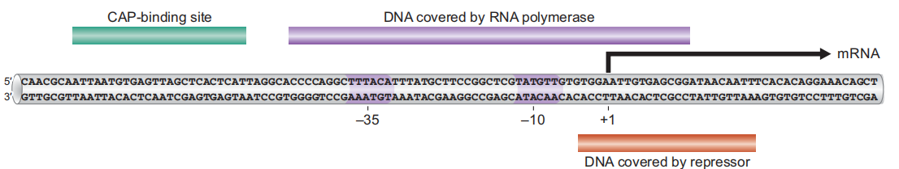
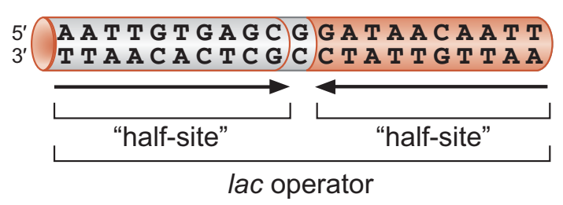
How a repressor works
on the lac operon?
The lac operator: This 21-bp sequence is two fold symmetric and is recognized by two subunits of Lac repressor, one binding to each half-site.
The lac operator overlaps the promoter, enabling repressor-mediated blocking RNA polymerase binding to promoter.

Slide 27
Basal expression of the lac genes
RNA polymerase binds the lac promoter poorly in the absence of CAP, even when there is no functional repressor present.
This is because the sequence of the –35 region of the lac promoter is not optimal for its binding, and the promoter lacks an UP-element.

Slide 28
How an activator works
on the lac operon?
CAP binds as a dimer to a site (CAP site) ~60 bp upstream of the start site of transcription.
Upon binding, CAP helps polymerase bind to the promoter by interacting with the enzyme and recruiting it to the promoter.
This cooperative binding stabilizes the binding of polymerase to the promoter.

Slide 29
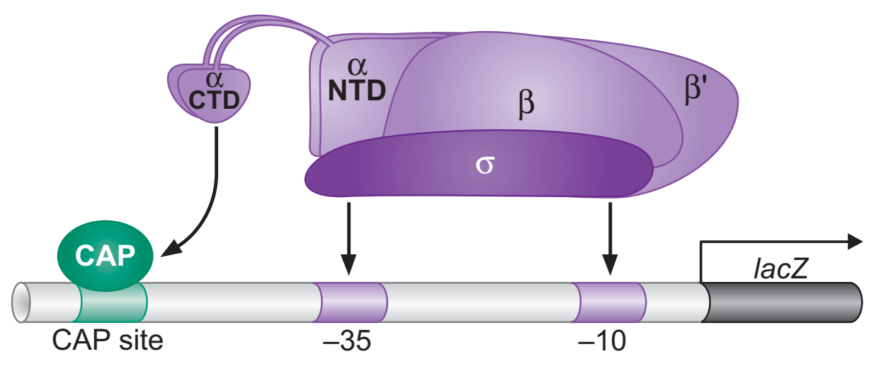
How CAP recruits RNA polymerase?
At the lac promoter, where there is no UP-element, the carboxy terminal domain (CTD) of the α subunit of RNA polymerase binds to CAP and adjacent DNA instead.

Slide 30
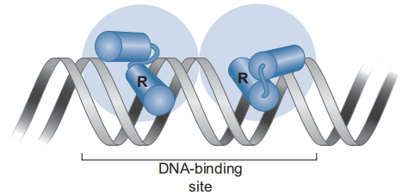
CAP and Lac Repressor Bind DNA Using a Helix-Turn-Helix Motif
The recognition helix—fits into the major groove of the DNA.
Lac repressor binds as a tetramer but CAP binds as a dimer.

Slide 31
How does lactose control the lac operon?
?

Slide 32
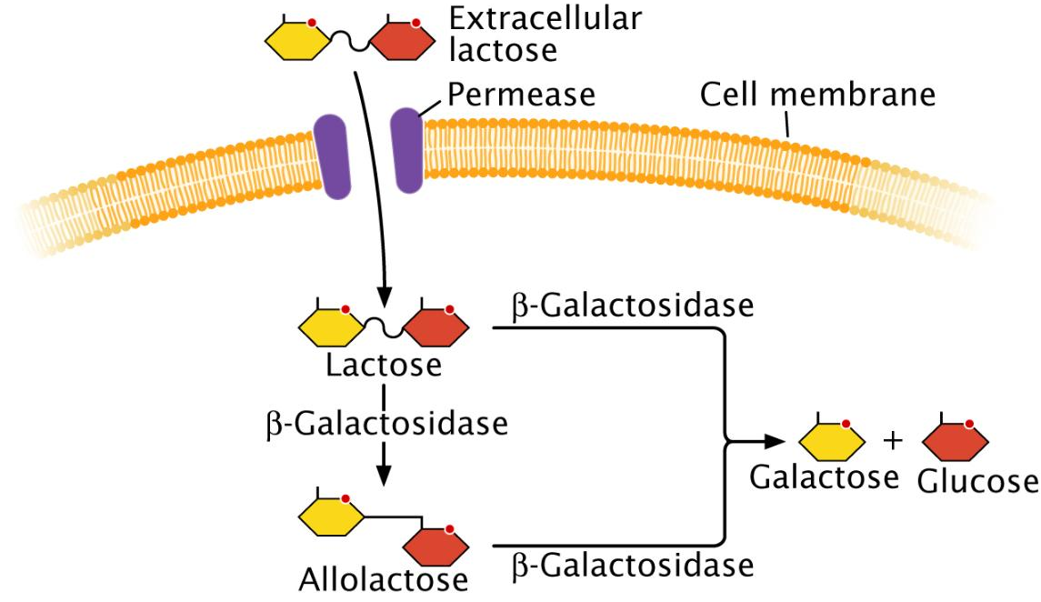
How does lactose control the lac operon?
Expression of the lac genes is leaky, ensuring a low level of β-galactosidase in the cell even in the absence of lactose.
异乳糖

Slide 33
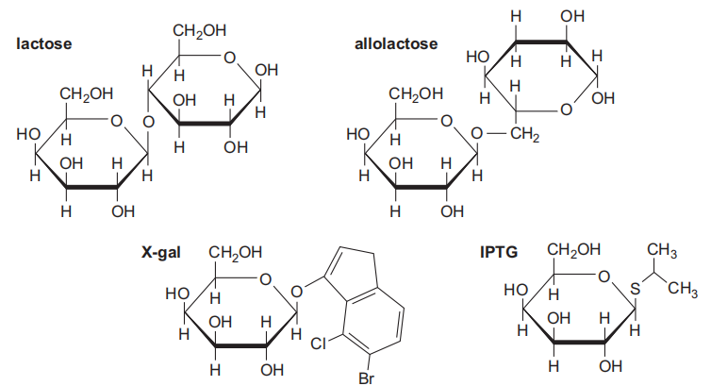
The inducer of the lac operon is allolactose (异乳糖)
β-Galactosidase
transglycosylation
转糖基作用

Slide 34
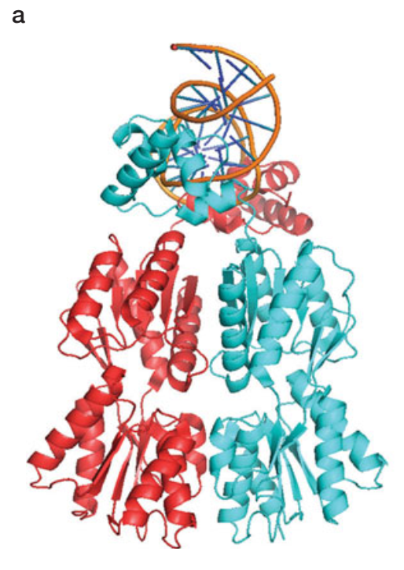
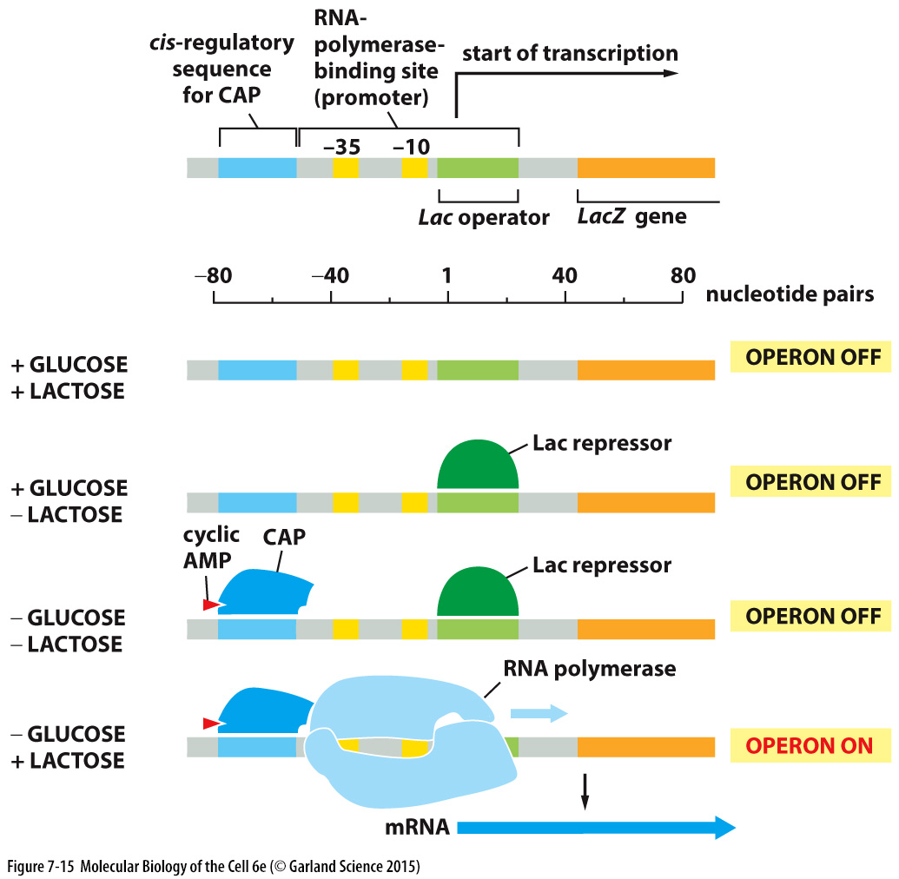
The Activities of Lac Repressor Are Controlled Allosterically by Allolactose
In the absence of allolactose, the repressor is present in a form that binds its site on DNA (and so keeps the lac genes switched off ).

Slide 35
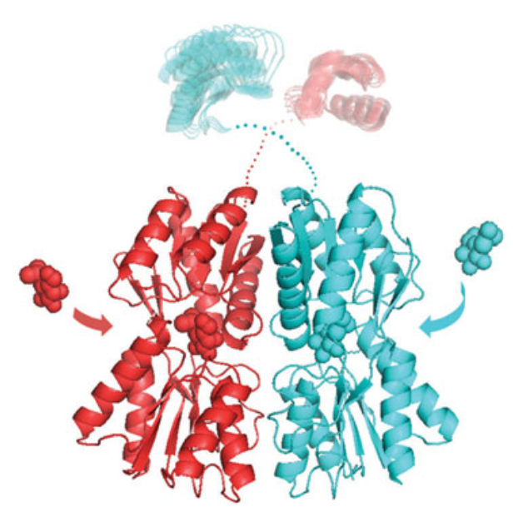
The Activities of Lac Repressor Are Controlled Allosterically by Allolactose
Allolactose binds to the Lac repressor and triggers a conformational change, resulting in disengagement of repressor form operator and ridding (解除) repression.

Slide 36
How does glucose control the lac operon?
Glucose lowers the intracellular concentration of a small molecule, cAMP which is the allosteric effector for CAP: only when CAP is complexed with cAMP does the protein adopt a conformation that binds DNA.
High glucose
Low glucose
Adenylate
cyclase
ATP
cAMP
腺苷酸环化酶
Low cAMP
High cAMP

Slide 37
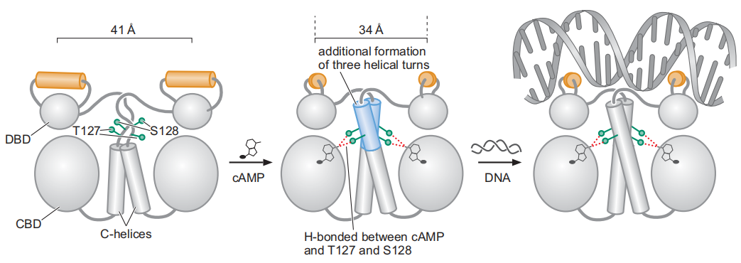
The Activities of CAP Are Controlled Allosterically by cAMP
Only when glucose levels are low (and cAMP levels high) does CAP bind DNA and activate the lac genes.
Activate
lac genes

Slide 38
Lactose and glucose coordinate the lac gene transcription through lac repressor and CAP
Allolactose
High cAMP

Slide 39
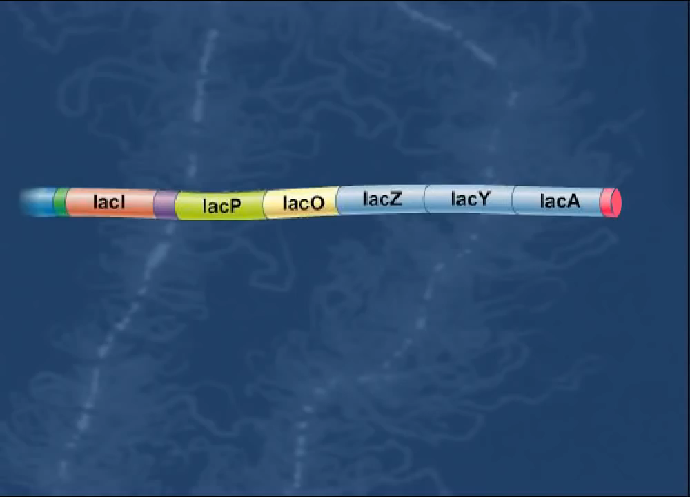
Video

Slide 40
A Repressor Controls the Tryptophan(丝氨酸) operon
An Activator and a Repressor Together Control the lac Genes (the lac operon 乳糖操纵子)
Alternative σ Factors Direct RNA Polymerase to Alternative Sets of Promoters
NtrC and MerR: Transcriptional Activators That Work by Allostery (变构) Rather than by Recruitment
Gal Repressor Holds RNA Polymerase at the Promoter Rather than Excluding It
AraC and Control of the araBAD Operon by Antiactivation (阿拉伯糖操纵子)

Slide 41
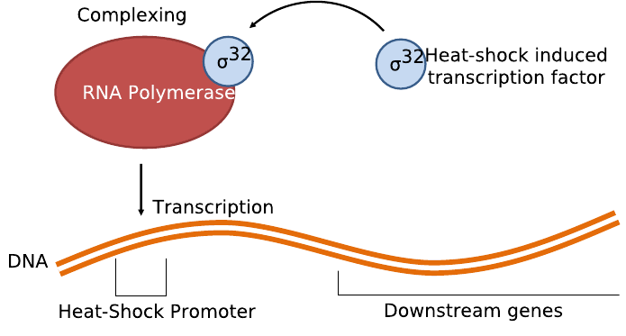
Alternative σ Factors Direct RNA Polymerase to Alternative Sets of Promoters
E. coli encodes several other σ subunits that can replace σ⁷⁰ under certain circumstances and direct the polymerase to alternative promoters.
Heat shock
σ³²
σ⁷⁰
Heat shock
σ⁵⁴ >> nitrogen metabolism

Slide 42
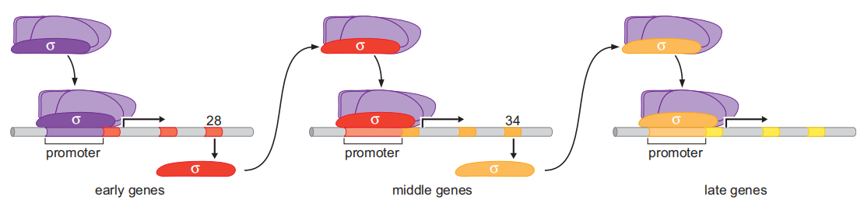
Alternative σ factors control the ordered expression of genes in a bacterial virus
Alternative σ factors control the life cycle of bacteriophage SPO1 .
σ⁷⁰

Slide 43
A Repressor Controls the Tryptophan(丝氨酸) operon
An Activator and a Repressor Together Control the lac Genes (the lac operon 乳糖操纵子)
Alternative σ Factors Direct RNA Polymerase to Alternative Sets of Promoters (Bacteriophage SPO1)
NtrC and MerR: Transcriptional Activators That Work by Allostery (变构) Rather than by Recruitment
Gal Repressor Holds RNA Polymerase at the Promoter Rather than Excluding It
AraC and Control of the araBAD Operon by Antiactivation (阿拉伯糖操纵子)

Slide 44
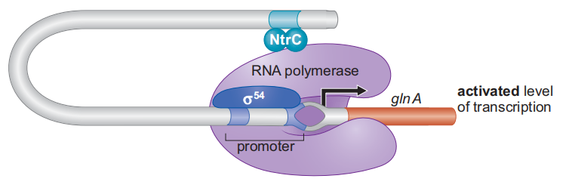
NtrC Activates Transcription by Allostery
low nitrogen
nitrogen
metabolism
Once activated, NtrC binds to the DNA sites far from the gene and interacts with σ⁵⁴.
NtrC has ATPase activity. NtrC induces a conformational change in a pre-bound RNA polymerase, triggering transition from a stable closed complex to the open complex.

Slide 45
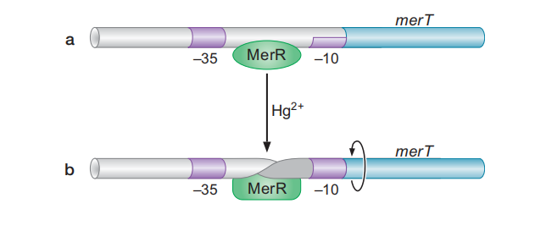
MerR Activates Transcription by Twisting Promoter DNA
Polymerase
Hg²⁺-
No transcription
Mercury (汞) resistance
In the absence of Hg²⁺, the binding of MerR locks the promoter in this unpropitious conformation—polymerase can bind, but can’t initiate transcription.

Slide 46
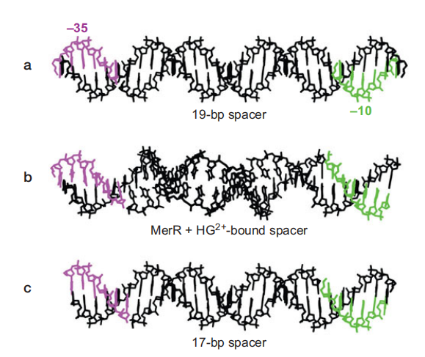
Structure of a merT- like promoter
=
The merT promoter
σ⁷⁰ preferred promoter
MerR+Hg²⁺
Twist
The merT promoter is unusual. The distance between the –10 and –35 elements is 19 bp instead of the 15–17 bp typically found in an efficient σ⁷⁰ promoter.

Slide 47
MerR Activates Transcription by Twisting Promoter DNA
Polymerase
Hg²⁺-
No transcription
Mercury (汞) resistance
Polymerase
Transcription
activation
Hg²⁺+
When MerR binds Hg²⁺, the protein undergoes a conformational change that causes the DNA in the center of the promoter to twist and restores the disposition of the –10 and –35 regions

Slide 48
A Repressor Controls the Tryptophan(丝氨酸) operon
An Activator and a Repressor Together Control the lac Genes (the lac operon 乳糖操纵子)
Alternative σ Factors Direct RNA Polymerase to Alternative Sets of Promoters (Bacteriophage SPO1)
NtrC and MerR: Transcriptional Activators That Work by Allostery (变构) Rather than by Recruitment
Gal Repressor Holds RNA Polymerase at the Promoter Rather than Excluding It
AraC and Control of the araBAD Operon by Antiactivation (阿拉伯糖操纵子)

Slide 49
Gal Repressor Holds RNA Polymerase at the Promoter Rather than Excluding It
In the absence of galactose (半乳糖), the repressor keeps the genes off. In this case, the repressor interacts with the polymerase in a manner that inhibits transition from the closed to open complex.

Slide 50
A Repressor Controls the Tryptophan(丝氨酸) operon
An Activator and a Repressor Together Control the lac Genes (the lac operon 乳糖操纵子)
Alternative σ Factors Direct RNA Polymerase to Alternative Sets of Promoters (Bacteriophage SPO1)
NtrC and MerR: Transcriptional Activators That Work by Allostery (变构) Rather than by Recruitment
Gal Repressor Holds RNA Polymerase at the Promoter Rather than Excluding It
AraC and Control of the araBAD Operon by Antiactivation (阿拉伯糖操纵子)

Slide 51
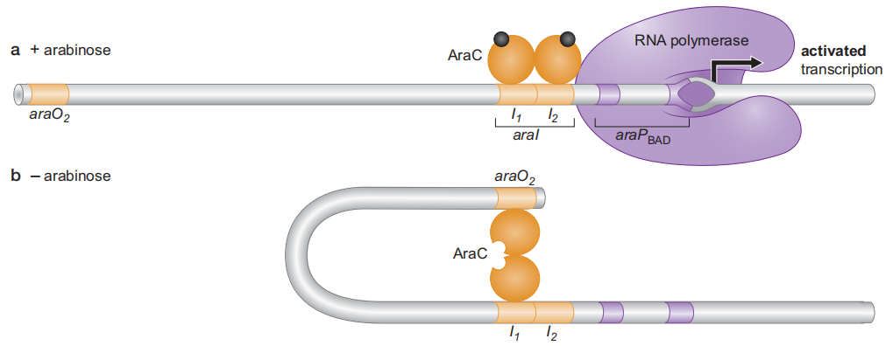
Control of the araBAD operon
arabinose metabolism
When arabinose is present and glucose is absent, AraC binds that sugar and adopts a configuration that allows it to bind DNA as a dimer to the adjacent half-sites, araI₁ and araI₂ , thereby activating gene expression.
The monomer of AraC at araI₂ is required for gene activation.
Notes:
Unlike the cases of lac and gal genes, where a repressor and an activator work together, here two activators work together: AraC and CAP

Slide 52
Control of the araBAD operon
No transcription
In the absence of arabinose, the araBAD genes are not expressed.
When not bound to arabinose, AraC adopts a different conformation and binds DNA in a different way: one monomer still binds the araI1 site, but the other monomer binds a distant half-site called araO₂, forming a loop.

Slide 53
Outline
Principles of transcriptional regulation 转录调控的基本原理
Regulation of transcription initiation: examples from prokaryotes 转录起始调控
The case of bacteriophage λ: layers of regulation 噬菌体λ: 多层次的转录调控

Slide 54
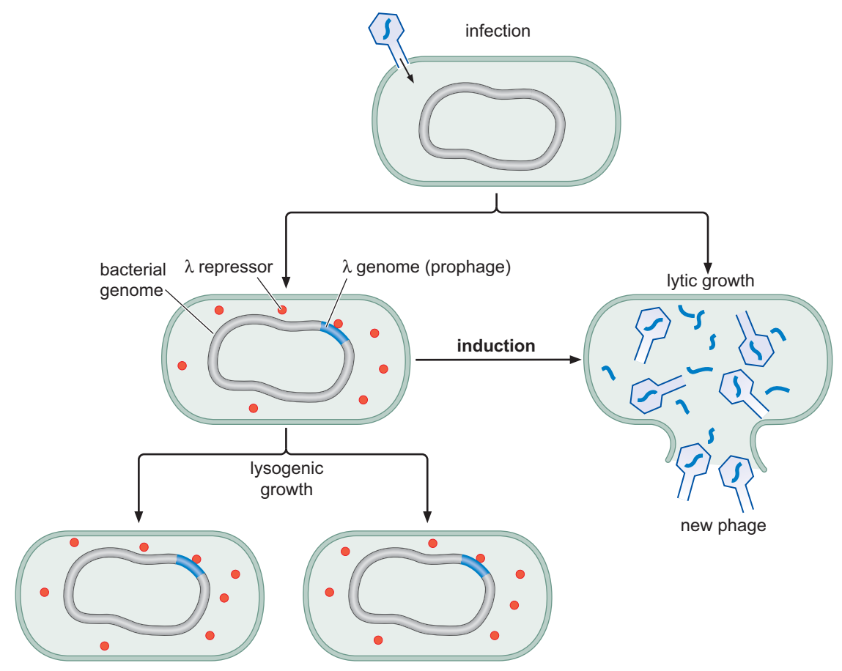
Growth and induction of λ lysogen
裂解性生长
溶原性生长
DNA damage
Stable
Prophage
(前噬菌体)
Notes:
Lysogeny—the alternative propagation pathway—involves integration of the phage DNA into the bacterial chromosome
Lytic growth requires replication of the phage DNA and synthesis of new coat proteins.

Slide 55
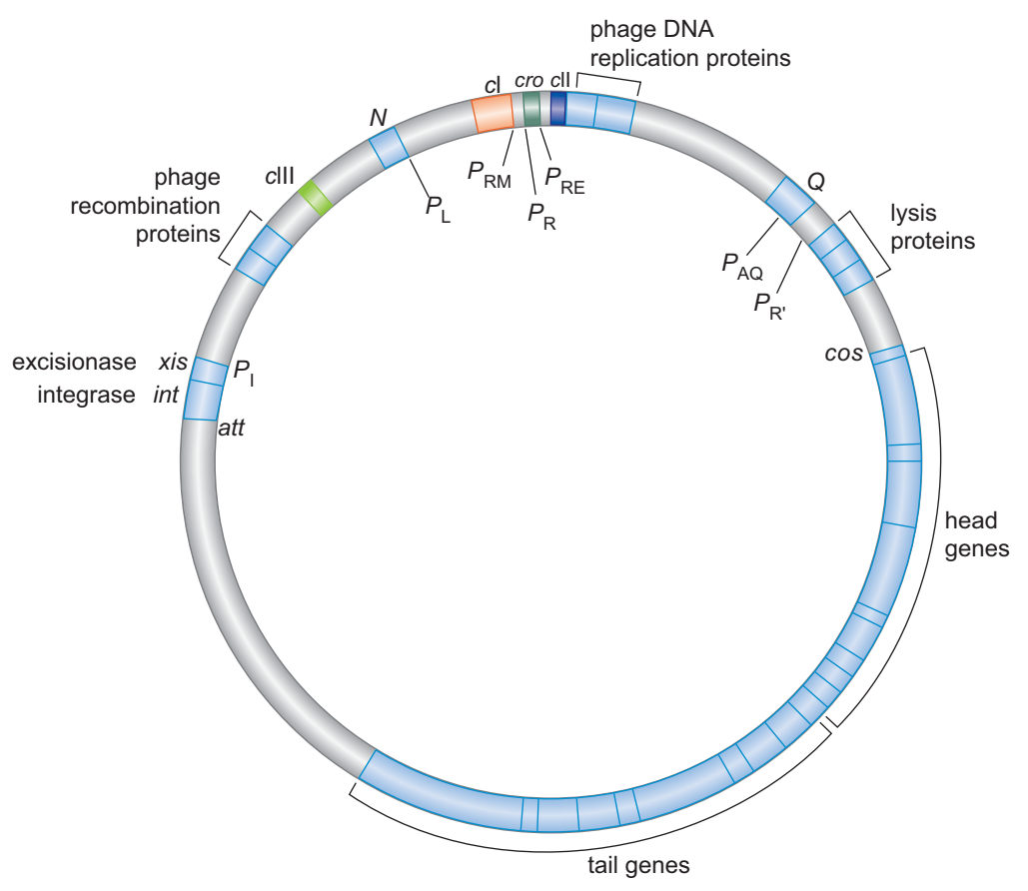
Map of bacteriophage λ
~ 50 genes in
50-kb genome

Slide 56
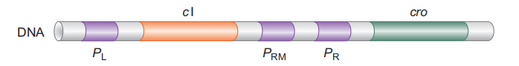
Promoters in the right and left control regions of bacteriophage λ
Strong
Strong
Weak
P_{R} and P_{L} are strong, constitutive promoters; that is, they bind RNA polymerase efficiently and direct transcription without help from an activator.
P_{RM} is a weak promoter and only directs efficient transcription when an activator is bound just upstream.

Slide 57
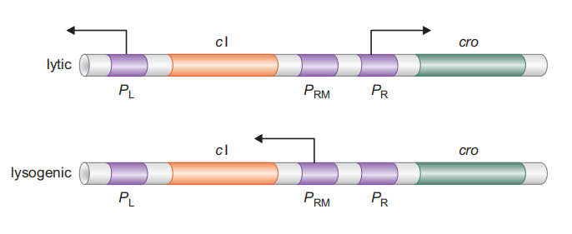
Transcription in the λ control regions in lytic and lysogenic growth

Slide 58
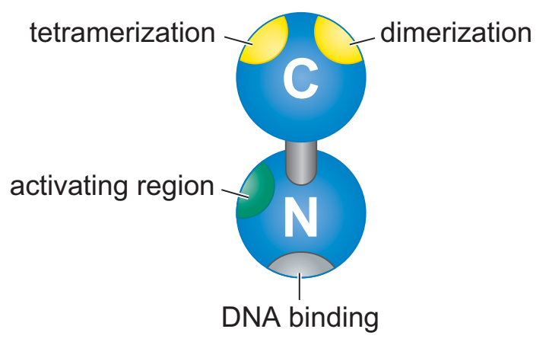
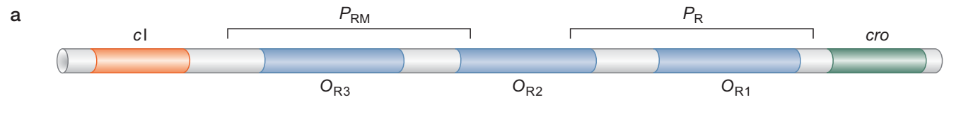
How to control transcription?
λ repressor
Cro
The cI gene encodes λ repressor, which can both activate and repress transcription, however, Cro only represses transcription.

Slide 59
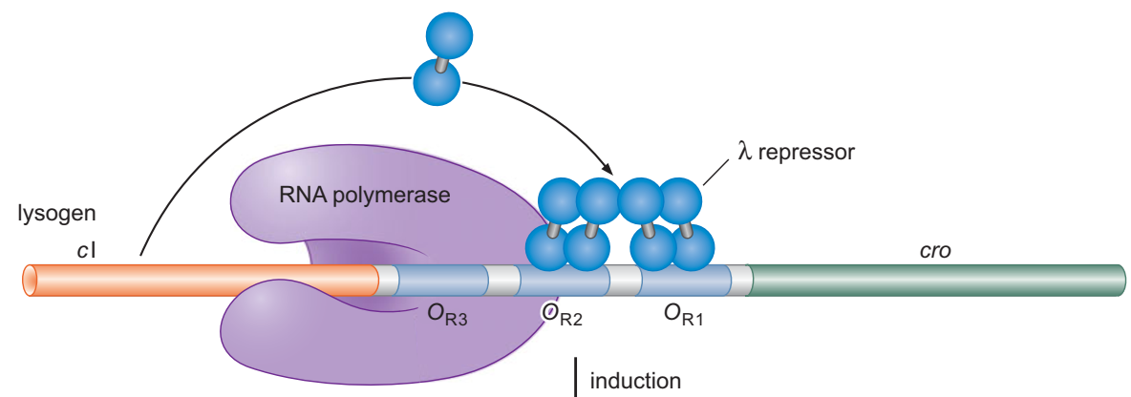
How to control transcription?
Positive feedback
regulation
recruit
inhibit
P_{R} Off
P_{RM} ON
When functioning as a repressor, it binds to sites that overlap the promoter P_{R} and excludes RNA polymerase.
As an activator, λ repressor works like CAP—by recruitment of RNA polymerase.
Notes:
During lysogeny, P_{RM} is on while P_{R} (and P_{L}) are off. Repressor bound cooperatively at O_{R1} and O_{R2} blocks RNA polymerase binding at P_{R}, repressing transcription from that promoter (Fig. 18-27). But repressor bound at O_{R2} activates transcription fromP_{RM}.

Slide 60
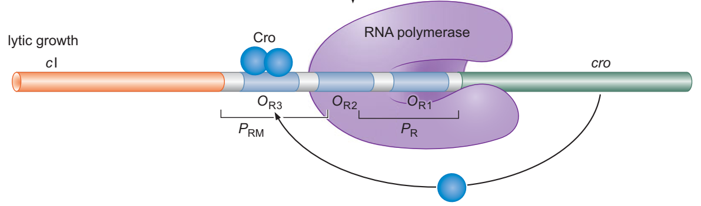
How to control transcription?
For lytic growth, a single Cro dimer is bound to O_{R3} ; this site overlaps P_{RM} and so Cro represses this weak promoter.
As neither repressor nor Cro is bound to O_{R1} and O_{R2} ,P_{R} binds RNA polymerase and directs transcription of lytic genes; P_{L} does likewise. Recall that both P_{R} and P_{L} are strong promoters that need no activator.
Notes:
This action ensures that the decision to induce is irreversible.

Slide 61
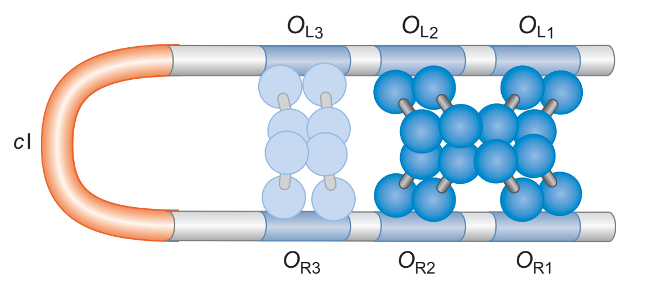
Interaction of repressors at O_{R} and O_{L}
P_{L}
P_{RM} P_{R}

Slide 62
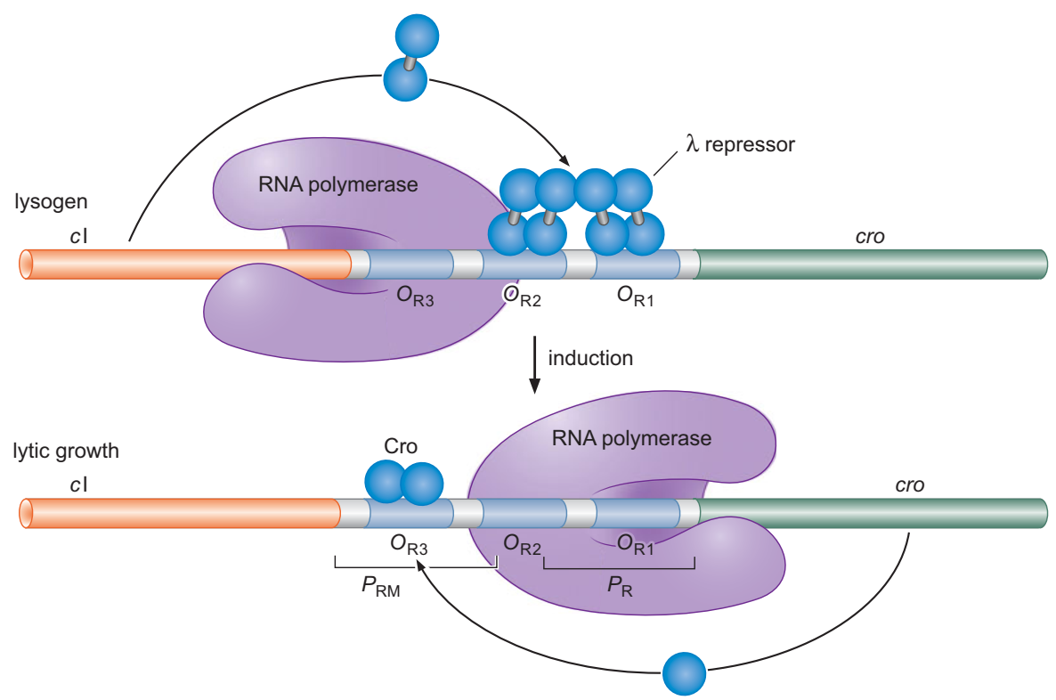
How to induce lysogenic growth?
?

Slide 63
DNA damage induce lysogenic growth
DNA damage
Activated RecA
Notes:
LexA
The cleavage reaction removes the carboxyterminal domain of repressor, and so dimerization and cooperativity are immediately lost.

Slide 64
Loss of cooperative repression by
cleavage of λ repressor
P_{L}
P_{RM} P_{R}

Slide 65
Take-home messages
An Activator and a Repressor Together Control the lac Genes (the lac operon 乳糖操纵子)
Alternative σ Factors Direct RNA Polymerase to Alternative Sets of Promoters
NtrC and MerR: Transcriptional Activators That Work by Allostery (变构) Rather than by Recruitment
AraC and Control of the araBAD Operon by Antiactivation (阿拉伯糖操纵子)
The case of bacteriophage λ: layers of regulation

Slide 66
Think over (4/7)
How to apply operons?

Slide 67
Think over (3/31)
The shortest intron in mouse?
10 nt, TCR family
The longest intron in mouse?
270000 nt, Adar
The shortest intron in human?
10 nt, Hox
The longest intron in human?
222000 nt, Titin
1. How such long introns are spliced?
2. Is intron essential?

Slide 68
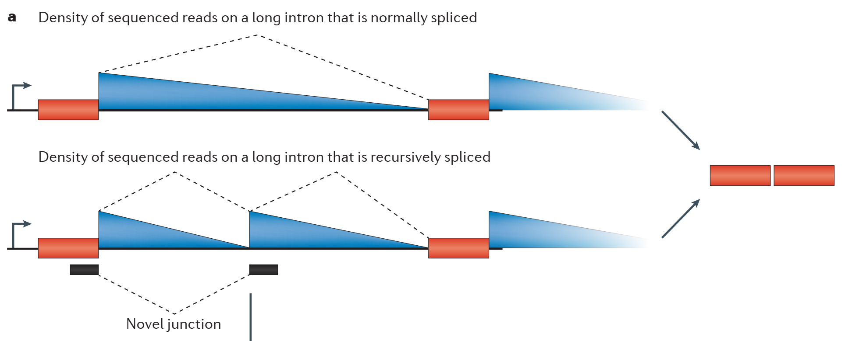
Recursive splicing
Duff et al. 2015 Nature
Sibley et al. 2015 Nature
Sibley et al. 2016 Nat Rev Genet

Slide 69
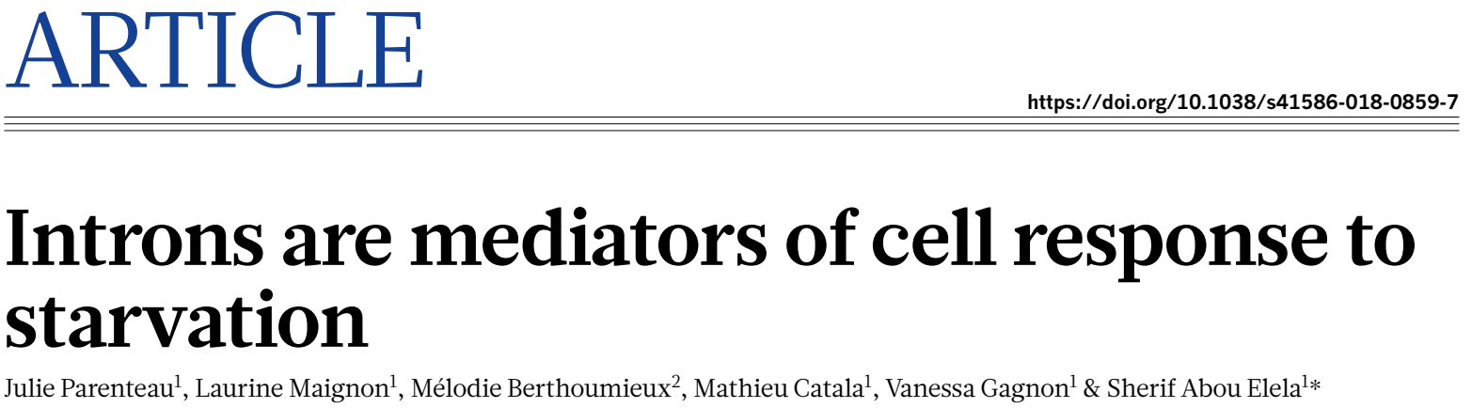
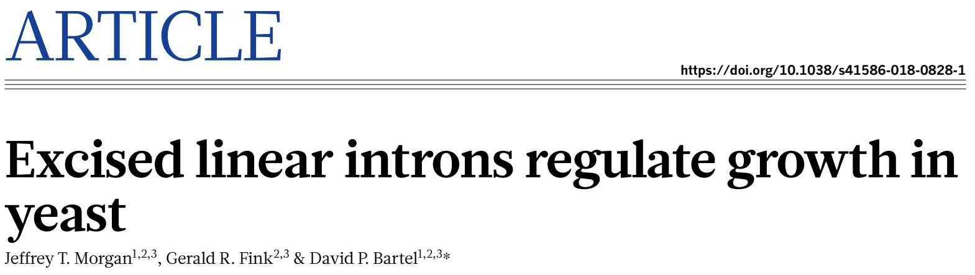
Certain introns are functional
Nature 2019

